Slide 1
Session 6
Object Oriented Concepts and Java Implementation-II

Slide 2
Review
An object consists of state and a behavior.
A class acts as a blueprint for a group of objects that have the same properties and behavior.
Abstraction is ignoring the data that is not required and concentrating only on data relevant to the application.
Encapsulation is the process of hiding the implementation details of an object from its user.
The variables and methods of a class are accessed by the instances of that class.
Dot notation is used to access members of an object.
A constructor initializes an object when created.

Slide 3
Objectives
Explain Inheritance
Design an example to implement Inheritance
List the features of Inheritance
Explain Polymorphism
Design an example to implement Polymorphism
List the features of Polymorphism
Identify the access specifiers and method modifiers

Slide 4
Inheritance 2-1
Inheritance
Keyword extends is used to inherit a class
Builds a hierarchy of classes
Allows to inherit the properties and methods of base class
Child class is a specialized class of the Parent class

Slide 5
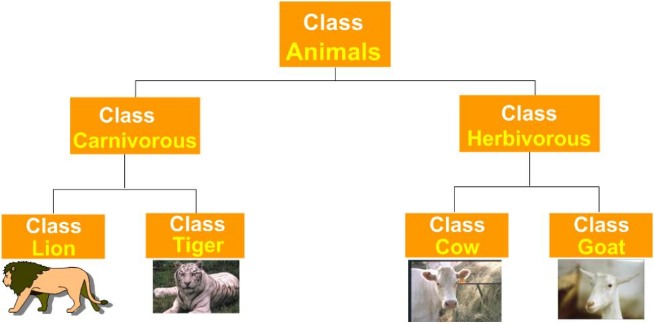
Inheritance 2-2
Parent class / Base class / Superclass
Subclass / Derived class

Slide 6
Advantages of Inheritance
Advantages
Reusability of code
Subclass can be customized easily
Data and methods of superclass are available to subclass
Designing applications becomes simpler

Slide 7
Inheritance
Keyword extends is used.
Accessing members of the superclass in the subclass.
class Car extends Vehicle {
/** Constructor. */
Car() { }
/** Display the details of the Car from the derived class. */
void show() {
System.out.println("Lines are from derived class Car");
System.out.println("Name of the vehicle - " + name);
System.out.println("Color of the Vehicle - " + color);
System.out.println("Number of seats - " + seats);
System.out.println("==============================");
}
}
class Vehicle {
/** Stores the name of the vehicle. */
protected String name = "Honda Civic";
/** Stores the color details. */
protected String color = "Red";
/** Stores the seat details. */
protected int seats = 5;
/** Constructor. */
Vehicle() {
}
. . . . . . .
. . . . . . .
Demonstration: Example 1

Slide 8
Derived Class Constructors 2-1
Base class constructor is invoked before the derived class
To invoke base class constructor super keyword is used
Constructor Inheritance
Derived class constructor has same name as that of the class

Slide 9
Derived Class Constructors 2-2
The syntax to invoke the superclass consructor is:
super(parameter_list) or super();
The parameters required by the constructor of the superclass are specified in the
parameter_list
The super() method always refers to the superclass immediately above the calling class.

Slide 10
Invoking Base class Constructor
Usage of the keyword super.
Author(String str) {
name = str;
System.out.println("Printing from the Author class");
System.out.println("The name is " + name);
}
class FictionAuthor extends Author {
/** Stores the storytype of the author. */
String storytype;
/** Derived class Constructor.
@param name passed to the constructor
@param type passed to the constructor */
FictionAuthor(String name, String type) {
super(name);
storytype = type;
System.out.println("Printing from the Fiction Author class");
System.out.println("Type is " + storytype);
}
}
Calls the super class constructor
Demonstration: Example 3

Slide 11
Polymorphism 2-1
Polymorphism means “many forms”.
It is described as “one interface, many implementations”.
It helps to write code that does not depend on specific types.
It is the capability of a method to do different things based on the object that is acting upon it.

Slide 12
Polymorphism 2-2
Derived Class - Draws and moves Triangle
Triangle
draw () {
DrawTriangle
}
move () {
MoveTriangleVertices
}
Base Class
(Interface)
Multiple inputs talking to one interface. Depending on input, output is decided
Derived Class - Draws and moves Rectangle
Shape
Rectangle
draw () {
DrawRectangle
}
move () {
MoveRectangleCorner
}
draw ()
move ()
Derived Class - Draws and moves Pentagon
Pentagon
draw () {
DrawPentagon
}
move () {
MovePentagonVertices
}

Slide 13
Method Overloading 2-1
Method Overloading
More than one methods having same name in the class
Argument List varies in type and / or numbers
Methods have different argument list

Slide 14
Method Overloading 2-2
Usage of methods with same name.
Argument lists varying in type and / or number.
void display() {
System.out.println("No arguments are there for displaying !!");
}
void display(int num, int num1) {
System.out.println("The two integer numbers are :" + num + " " + num1);
}
void display(double count) {
System.out.println("Inside the display(double) method :" + count);
}
void display(double count) {
System.out.println("Inside the display(double) method :" + count);
}
public static void main(String [] arg) {
int count = 25;
DisplayNumber dispObj = new DisplayNumber();
dispObj.display();
dispObj.display(10 , 20);
/* No method with a single argument of type int exists,
int value is automatically promoted to double
*/
System.out.println("Invoking the display(double) method"
+ "with an int variable: " + count);
dispObj.display(count);
dispObj.display(25.5);
}
Method accepting no argument is invoked
Method accepting two int arguments is invoked
Method accepting a double argument is invoked
Method accepting a double argument is invoked
Demonstration: Example 4

Slide 15
Method Overriding 2-1
Method Overriding
Subclass and Superclass have methods with same name and type signature
super.methodname() is used to call the superclass version of the method
Overridden method of the subclass will be invoked when called by a subclass object
Method in the superclass will be hidden

Slide 16
Method Overriding 2-2
Methods with same name and type signatures in the superclass and subclass.
Invokes the superclass method
public static void main(String [] arg) {
Square sqObj = new Square(15);
sqObj.getPerimeter();
Rectangle rectObj = new Rectangle(10, 15);
rectObj.getPerimeter();
}
Invokes the subclass method
class Square {
. . . . . . . .
. . . . . . . .
* Calculating the perimeter of a square .*/
void getPerimeter() {
System.out.println("Perimeter of a square is " + (4 * length));
}
}
class Rectangle extends Square {
. . . . . . . .
. . . . . . . .
* Calculating the perimeter of a rectangle .*/
void getPerimeter() {
System.out.println("Perimeter of a Rectangle is "
+ (2 * (length + width)));
}
}
Demonstration: Example 5

Slide 17
Access Specifier 2-1
Information hiding is one of the most important features of OOPs.
Reasons for information hiding are:
  Changes made to any implementation details will not affect code that uses this class.
  Prevents accidental erasure of data by users.
  The class is easy to use.
Access Specifiers
private
protected
public
default

Slide 18
Access Specifier 2-2
public
private
Accessible to members and non members of the class
Accessible only to members of the class
protected
default
Accessible to members of the class and members of its subclass
Accessible to members of the class in the same package

Slide 19
Method Modifiers
Method Modifiers
static
final
synchronized
abstract

Slide 20
static Modifier 3-1
Programmer might need to access a class member independent of any object of the class.
The keyword static is used to create such a member.
Such a member is accessed before any object of the class is created.
  For example, main() method is declared static as it can be invoked by the Java runtime system without creating an instance of the class.

Slide 21
static modifier 3-2
Rules
Can call other static methods
Must access static data
Cannot use super or this keyword
Syntax for invoking a static method is:
  Classname.methodname();

Slide 22
static modifier 3-3
static methods are invoked using class names.
public static void main(String [] arg) {
//initializing a variable
double inch = 66;
double feet = InchesToFeet.convert(inches);
System.out.println(inch + " inch is " + feet + " feet.");
}
class InchesToFeet {
/** Initializes a static variable. */
private static final int inches = 12;
/** Constructor. */
protected InchesToFeet() {
}
public static double convert(double in) {
return (in / inches);
}
……….
Demonstration: Example 6

Slide 23
final Modifier
final
Variable’s content cannot be modified
Methods cannot be overridden by subclass
Reference of object should not change

Slide 24
abstract Modifier 3-1
Certain methods in the superclass do not contain any logic and need to be overridden in the subclass.
The keyword abstract is used for such methods.
The subclass provides implementation details of such abstract methods.
The syntax is:
  abstract type method_name(parameter_list);
Any class that contains one or more abstract methods must be declared as abstract.
The class keyword should be preceded by the abstract keyword when declaring an abstract class.

Slide 25
abstract Modifier 3-2
abstract
Constructors and static methods cannot be abstract
Abstract method of superclass has to be implemented in subclass
Abstract class cannot be instantiated
An abstract class can have object references that can point to a subclass object.

Slide 26
abstract Modifier 3-3
Abstract methods do not have any implementation code.
abstract class Shape {
. . . . . . . . . . .
protected double length;
protected double width;
. . . . . . . . . . .
. . . . . . . . . . .
abstract double area();
}
class Square extends Shape {
/** Constructor.
*@param num passed to the constructor
*@param num1 passed to the constructor
*/
Square(final double num1) {
super(num1, num1);
}
/**
* Calculates the area of a square.
* @return length passed to the constructor
*/
double area() {
System.out.println("Area of a square is : ");
return length * width;
}
}
Demonstration: Example 7

Slide 27
Summary
Inheritance allows the creation of hierarchical classifications.
Inheritance allows the reusability of code.
All methods and properties of the base class are inherited by objects of the derived class except the constructors.
Polymorphism is the ability of different objects to respond to the same message in different ways.
Overloaded methods are examples of static polymorphism and overridden methods are examples of dynamic polymorphism.

Slide 28
Summary 2-2
Access specifiers are used to determine how the class members are accessed.
Some of the method modifiers in Java are static, final, abstract.

